Slide 1




RETURN PERIOD HYDROGRAPHS
TEAM 11
First week’s presentation

Slide 2
QUESTION?
How to produce 10y , 20y, 50y and 100y return period hydrographs estimation and associated flooded areas in the Var low valley?
How to use IDF curves? Analysis should focus on hydrological part and only simple hydraulic modeling can be used for the low valley for the different scenarios.

Slide 3
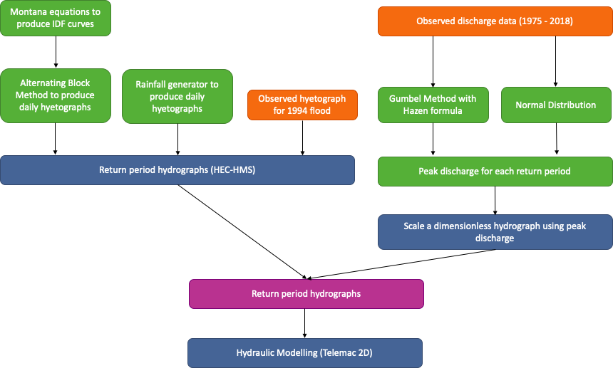
WORKFLOW

Slide 4
CATCHMENT CHARACTERISTICS

Slide 5
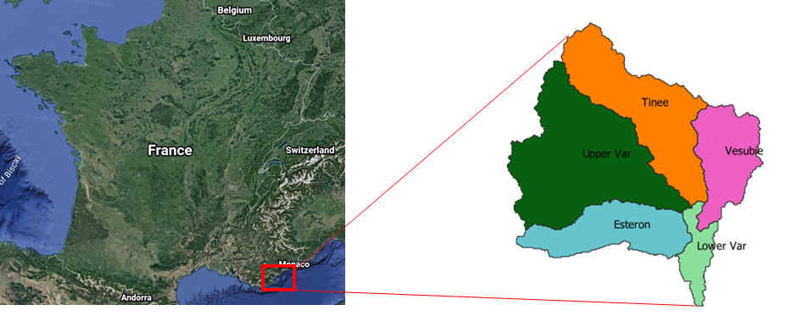
Var catchment is located in the south of France with a total area of about 2822 km².
It is composed of five sub-catchments.
Notes:
•Upper var with the area about 1087.47 km² is the biggest sub-catchment.

Slide 6
DATA PREPARATION USING IDF CURVE

Slide 7
Data preparation using IDF curve
Montana equation: I = a X t ^{-b}
I = Intensity (mm/hr)
t = duration (hr)
a & b = local coefficient statistically calculated
by Meteo France based on
measurement data from 1966 – 2012
a & b values for various return periods
Coefficients | 10 Yrs | 20 Yrs | 50 Yrs | 100 Yrs
a | 36.32 | 40.09 | 45.07 | 97.50
b | 0.65 | 0.65 | 0.65 | 0.82

Slide 8
Data Preparation : with IDF curve
Hyetograph obtained using alternative block method.
Objective is to construct hyetograph such that peak precipitation occurs in the middle of the storm
One of the recommended approaches to generate design storm among others (Sifalda and linear / exponential models)
Used as input for HEC-HMS

Slide 9
HYDROLOGICAL MODELLING
HEC-HMS

Slide 10
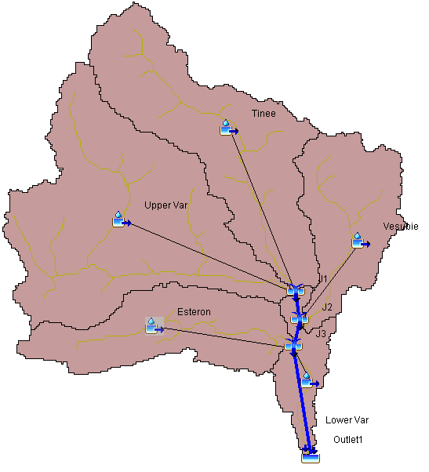
Hydrological modelling
HEC-HMS used for hydrological modelling.
Model setup:
5 sub-catchments, 3 junctions and 3 reaches
1 precipitation gage introduced, with 30 minutes interval
data for 24 hours
Catchment Parameters:
Peak discharge for 10 years return period : 6113 cms
Sub Basin | Curve Number | Imperviousness
Upper Var | 77 | 20
Tinee | 75 | 21
Esteron | 72 | 13
Vesubie | 73 | 17
Lower Var | 72 | 24

Slide 11
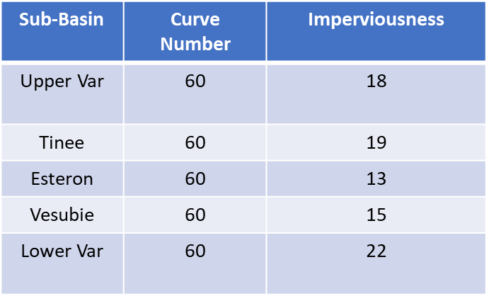
Hydrological modelling
Modification of the catchment parameters:
Peak discharge for various return periods
Return Period | Peak discharge (cms)
10 | 1700
20 | 2058
50 | 2557
100 | 4369

Slide 12
Results from Hydrological Modelling
Rainfall data depends upon the local coefficients. Hence, the representation of rainfall can be less accurate

Slide 13
DATA PREPARATION USING RAINFALL GENERATOR

Slide 14
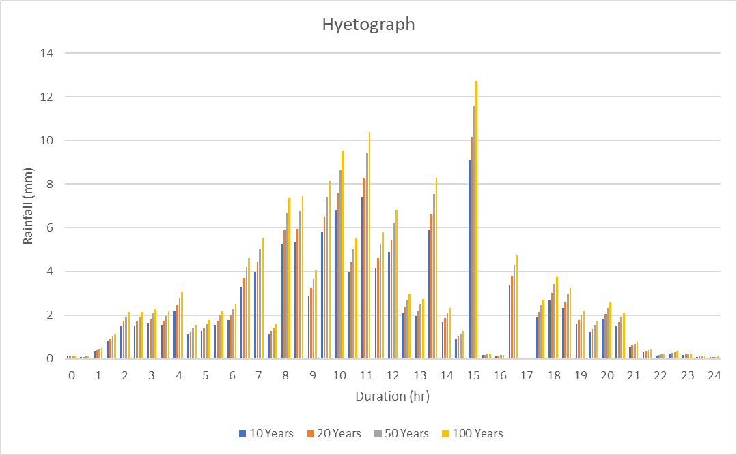
Data Preparation with rainfall generator
Unit hyetograph
Used as input rainfall data for HEC-HMS

Slide 15
HYDROLOGICAL MODELLING
HEC-HMS

Slide 16
Hydrological Modelling
Return Period | Peak discharge (cms)
10 Years | 1720
20 Years | 2096
50 Years | 2640
100 Years | 3114
Rainfall data are more representative of historical patterns, hence the hydrographs are more accurate

Slide 17
Flood Frequency Analysis

Slide 18
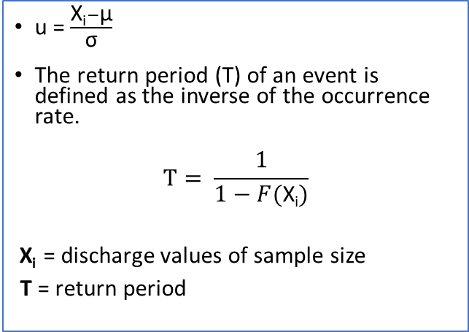
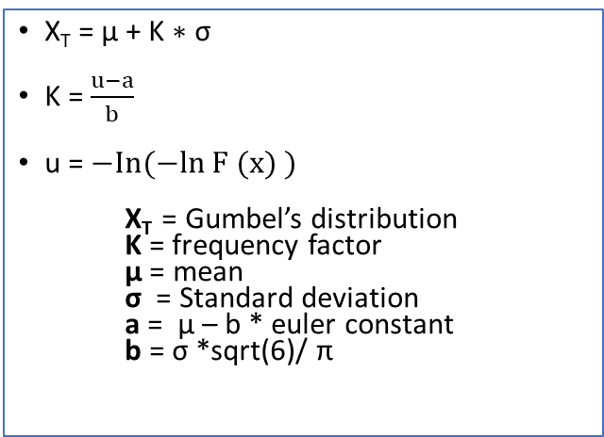
Methods
Gumbel distribution
Normal Distribution
X_{T} = µ + K ∗ σ
K = $\frac{u−a}{b}$
u = $−In(−ln F (x) )$
X_{T} = Gumbel’s distribution K = frequency factor μ = mean σ = Standard deviation a = μ – b * euler constant b = σ *sqrt(6)/ π
u = $\frac{\text{X}\text{i}−\text{µ}}{\text{σ}}$
The return period (T) of an event is defined as the inverse of the occurrence rate.
$$T= \frac{1}{1−F(\text{X}\text{i})}$$
$\text{X}\text{i}$ = discharge values of sample size
T = return period

Slide 19

Procedure
Monthly peak flood data was assembled from 1975-2018 and 1994.
We sort the discharge data in increasing order.
We assign ranks to each value.
Calculate the probability of non-exceedance with Hasan’s formula:
𝐹 ($\text{X}\text{i}$) = 𝑟 − 0.5 /𝑛
Graphical representation of $u$ against the peak discharges.

Slide 20
Flood analysis by Gumbel’s Distribution
Return period (years) | Frequency (%) | Reduced Variate(u) | Discharge(m3/s) (1975-2018) | Discharge (1994)
10 | 99.17 | 4.79 | 710.01 | 1672.1
20 | 99.59 | 5.48 | 804.24 | 1900.06
50 | 99.83 | 6.40 | 928.6 | 2201
100 | 99.92 | 7.08 | 1022.6 | 2428.4

Slide 21
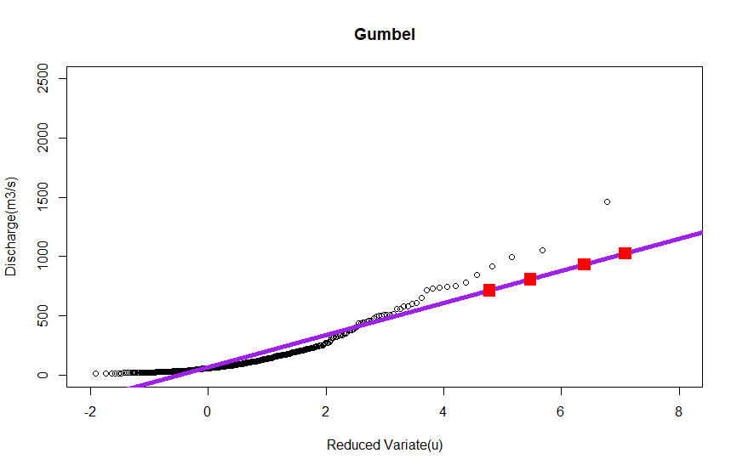
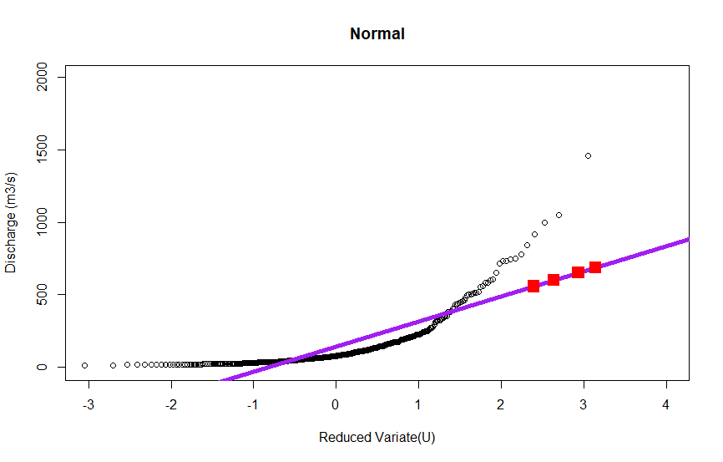
Flood frequency for 1975-2018
Gumbel (1975-2018)
Normal (1975-2018)

Slide 22
Flood analysis by Normal distribution
Return period (years) | Frequency (%) | Reduced Variate(u) | Discharge (1975-2018) | Discharge (1994)
10 | 99.17 | 4.79 | 556.1 | 1299.7
20 | 99.59 | 5.48 | 598.6 | 1402.43
50 | 99.83 | 6.40 | 650.17 | 1527.3
100 | 99.92 | 7.09 | 686.46 | 1615.1

Slide 23
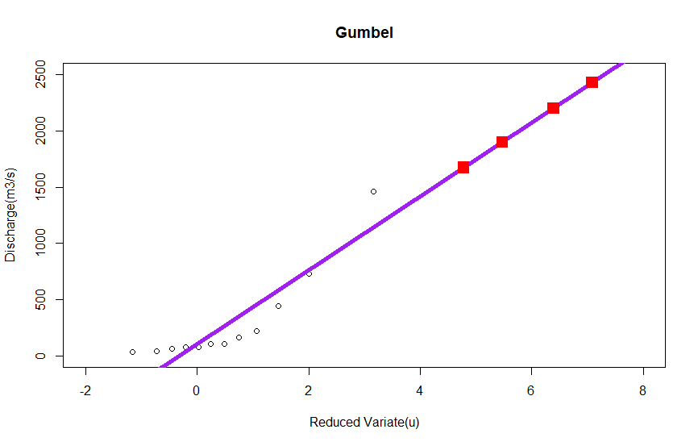
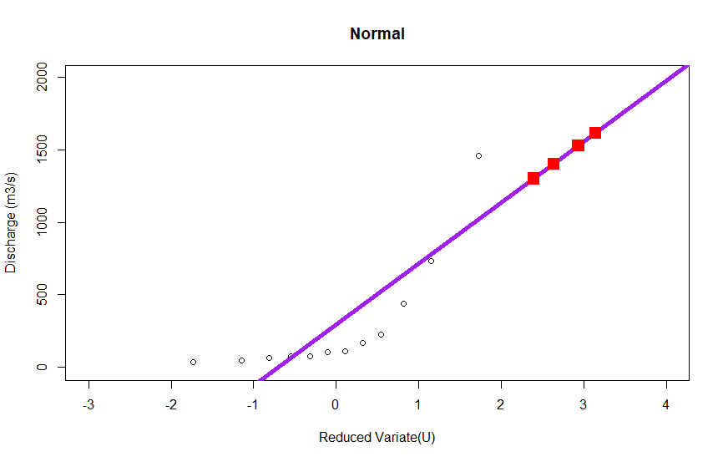
Flood frequency for 1994
Gumbel (1994)
Normal (1994)

Slide 24
FLOOD EXTENT
HYDRAULIC MODELLING (TELEMAC 2D)

Slide 25
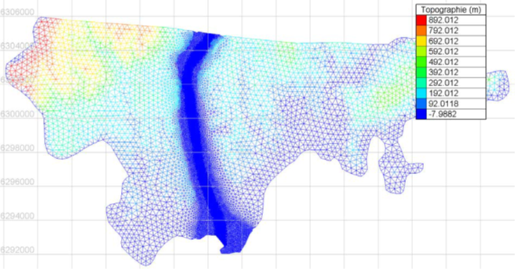
Model characteristics
Covers the area from the La Manda bridge to the airport
5m DEM resolution
Mesh resolution of 5m in the minor river bed, 50m in the major bed and up to 400m for the rest of the model
Notes:
TELEMAC-2D solves the depth-averaged Navier-Stokes equation utilizing both Finite-Element (FE) and Finite-Volume (FV) formulations. All of these formulations require that a spatial representation of the domain be created using a computational mesh.

Slide 26
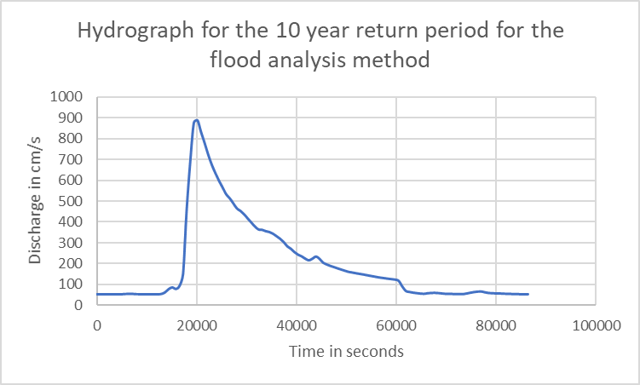
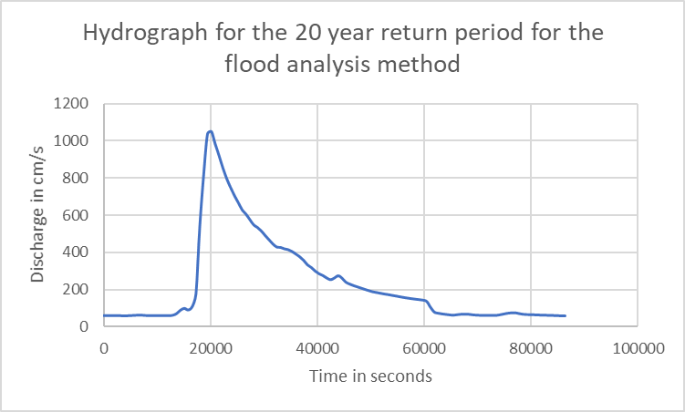
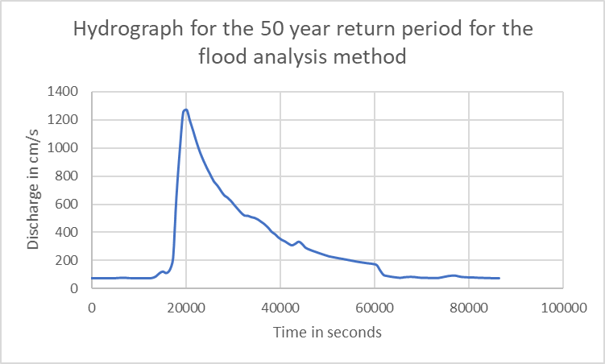

Simulations
Notes:
TELEMAC-2D simulation parameters ﬁle (*.cas) (inflow hydrograph)

Slide 27
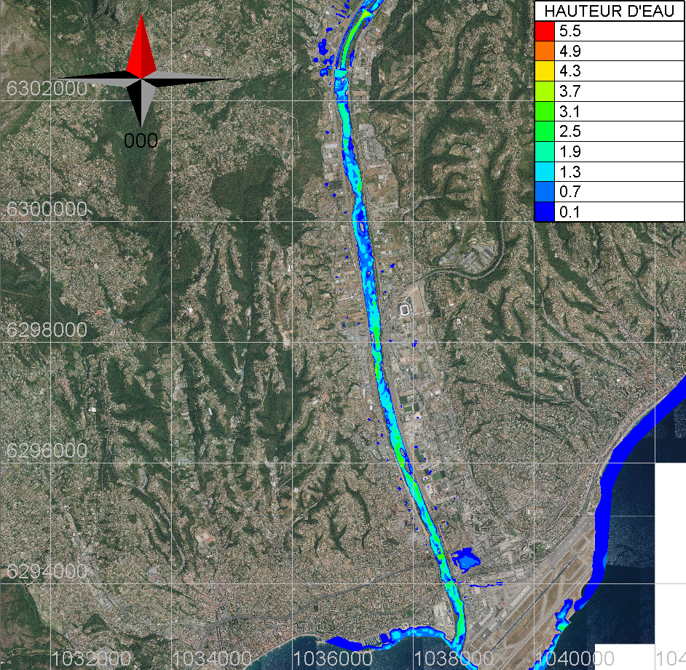

Results
Flood extend for the flood analysis method’s 10 years return period, 3h15 after the hydrograph peac
Flood extend for the flood analysis method’s 20 years return period, 3h25 after the hydrograph peac
Notes:
TELEMAC-2D simulation parameters ﬁle (*.cas) (inflow hydrograph)

Slide 28
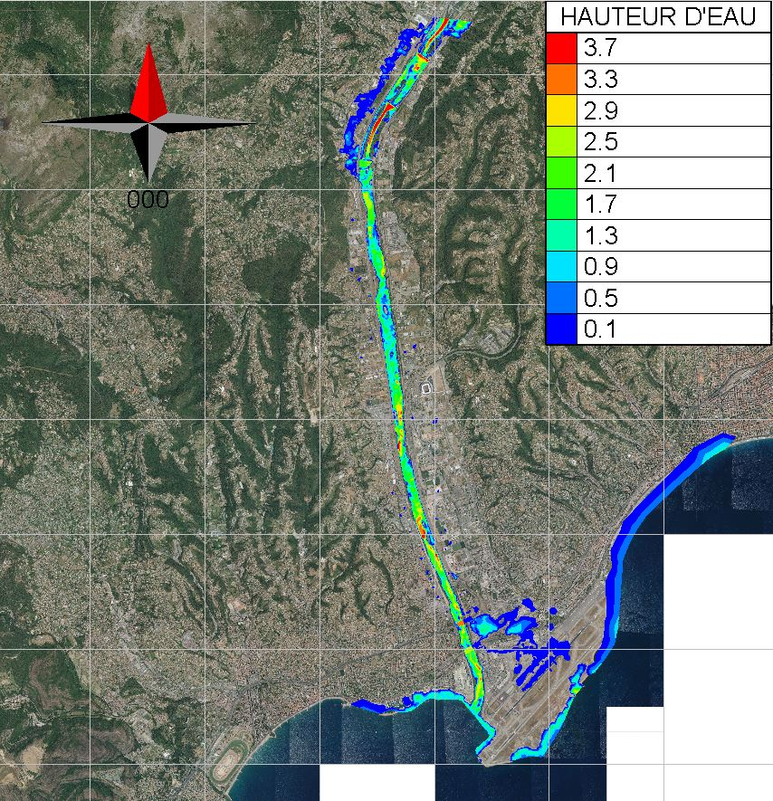
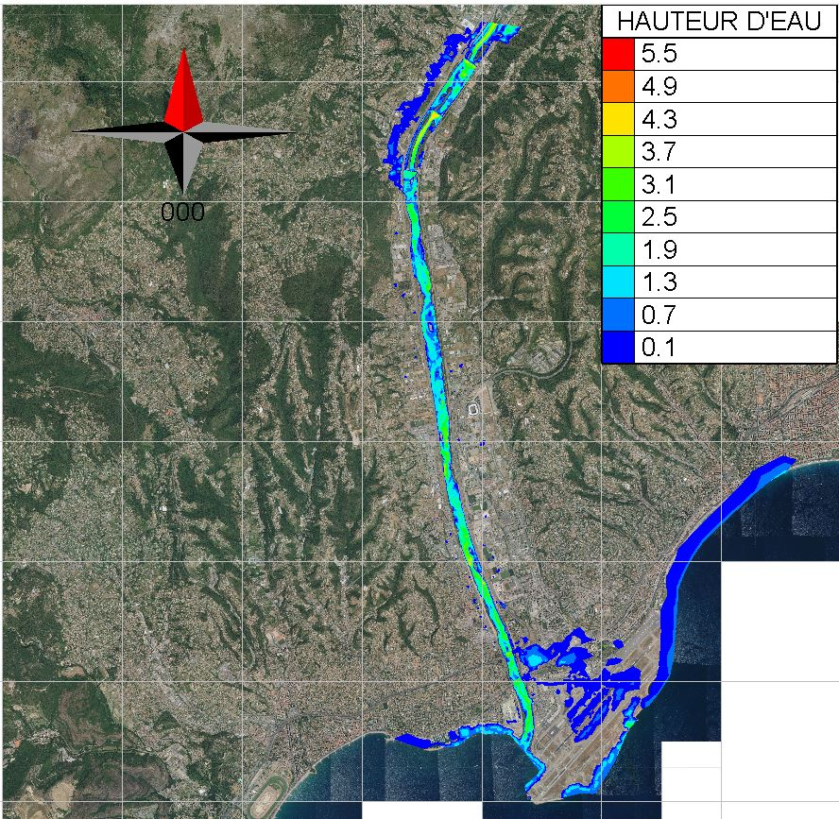
Results
Flood extend for the flood analysis method’s 50 years return period, 3h44 after the hydrograph peac
Flood extend for the flood analysis method’s 100 years return period, 3h44 after the hydrograph peac
Notes:
TELEMAC-2D simulation parameters ﬁle (*.cas) (inflow hydrograph)

Slide 29
Summary
Data generated from rainfall generator can be considered more accurate as compared to data generated from IDF curves, and hence produce better hydrographs.
Gumbel’s distribution is a better analysis method for extreme cases, in our case flood analysis.

Slide 30
References
Gumbel, E.J. (1935), "Les valeurs extrêmes des distributions statistiques" (PDF), Annales de l'Institut Henri Poincaré, 5 (2) : 115–158.
A. Hazen et G.S. Williams, Hydraulic Tables, New York, John Wiley and Sons, 1920, 3e éd.

Slide 31
Thank You

